Slide 1

Northeast Health Partners
RAE 2
May 14, 2025

Slide 2
Introductions

Slide 3

Check-In
Notes:
I want to thank everyone who has been attending the office hours for the past few months. We created this forum with the goal to distribute critical information to PCMPs prior to go-live, as well as, allow you to ask questions important to your practice.
Your engagement has been extremely helpful for the NHP team to know what support you need for the go-live. We are on this together!
We would like to extend the Office Hours to a monthly meeting for our PCMPs to:
Maintain a two-way communication
Provide training on important topics related to you as a PCMP
Build a PCMP community where you can also share information with your counterparts.
Before we do that, we want your feedback. We are going to take a few minutes to take a little survey to see how helpful the Office Hours are for you!

Slide 4
Question 1:
How helpful do you find the information shared during the sessions?

Slide 5
Question 2:
Please rate the content of the slides/virtual aids.

Slide 6
Question 3:
Please rate the format of the sessions.

Slide 7
Question 4:
Do the time and date of the sessions work for you?

Slide 8
Question 5:
What topics would you like to see covered in future sessions?

Slide 9

July 1st Go-Live Final Steps

Slide 10

Execute Agreement
Submit all Documents
Provider Training
NHP Network will be outreaching to providers individually.

Slide 11

PCMP Welcome Session – June 11th
NHP will host Welcome Onboarding Session at our Office Hours!
We will cover important info:​
NHP Overview​
Care Coordination Referral Process​
Walk thru new Website​
Introduce Practice Transformation Team​
Payment Process​

Slide 12
Access Stabilization Payment

Slide 13
Access Stabilization Payment Goals
Sustain access to primary care services for Health First Colorado members where access is under pressure, e.g. small, rural, and pediatric PCMPs
Increase proportion of Health First Colorado members seen by PCMPs.
More information visit HCPF Payment Fact Sheet here: https://hcpf.colorado.gov/sites/hcpf/files/ACC_Phase_III_PCMP_Payment_Fact_Sheet_March_2025.pdf

Slide 14
Eligibility Criteria
Small - PCMPs with 1-5 individual providers at the Tax ID level, based on claims from SFY 23/24. Each eligible provider must have a minimum of 10 paid primary care claims.
Rural - PCMPs that operate in a county classified as “rural” or “county with extreme access considerations,” based on the Colorado Department of Regulatory Agencies Regulation 4-2-53 (Appendix A).
Pediatric - PCMPs qualify as pediatric if at least 80% of their Health First Colorado members served are 0-18 years old during SFY 23/24

Slide 15
Additional Information
PCMPs that fall into more than one of these categories will only receive one Access Stabilization Payment.
Federally Qualified Health Center (FQHC), Rural Health Center (RHC), and Indian Health Service (IHS) PCMPs are not eligible for Access Stabilization.

Slide 16
Operational Timeline
By 4/25 – Department shares eligibility list with RAEs
Week of 4/28 – RAEs begin sharing eligibility with PCMP network
Notify all PCMPs of Access Stabilization eligibility status
Explain dispute process
Provider dispute window open until 5/23
5/23-6/23 Department reviews disputes & notifies providers
6/27 Final Eligibility List available to RAEs Rate Letters sent to PCMPs.

Slide 17
Eligibility Dispute Process
Upon receipt of notification, PCMPs may contest eligibility through a written dispute sent to their RAE
  RAEs will forward to the Department
PCMPs must provide documentation for why they believe they meet current eligibility criteria
  Proof that they match the eligibility criteria in the determination period
Disputes will be reviewed by HCPF and decisions will be communicated with PCMPs by the end of June.

Slide 18
Performance Measure Changes

Slide 19
Overview of Incentive Programs: Phase II and III
Phase II Performance Measures
3 Programs
  Key Performance Indicators (KPI)
  Behavioral Health Incentive Program (BHIP)
  Performance Pool
    Filter of unmet KPI Funds
25% pulled off of Admin PMPM from HCPF to fund KPI
  2/3 to KPI
  1/3 to Performance Pool + unearned KPI funds
Phase III Performance Measures
3 Programs
  Key Performance Indicators (KPI)
  Behavioral Health Incentive Program (BHIP)
  Investment Pool
    This is not yet described in detail
$4.50 pulled off of Admin PMPM from HCPF
  Distribution across KPI/PP is unknown
Performance Pool/Investment Pool is unknown

Slide 20
Overview of Incentive Programs: BHIP
Phase II BHIP
SUD Engagement
7-Day Follow-Up After Hospitalization for Mental Illness
7-Day Follow-Up After ED Visit for SUD
30-Day Follow-Up After Positive Depression Screen
  Gate Measure: Depression Screening Rates in PCMP Offices
Behavioral Health Screening for Foster Care
Phase III Performance Measures
Initiation & Engagement of Substance Use Disorder Treatment
  2 rates: Initiation & Engagement
Follow-Up After Hospitalization for Mental Illness
  2 rates: 7 Days & 30 Days
Follow-Up After ED Visit for SUD
  2 rates: 7 Days & 30 Days
Follow-Up After ED Visit for Mental Illness
  2 rates: 7 Days & 30 Days
Screening for Social Drivers of Health (SDOH)
  Food Insecurity
  Housing Instability
  Transportation Needs
  Utility Difficulties
  Interpersonal Safety

Slide 21
Overview of Phase III Differences: KPIs
Phase II Performance Measures
7 Measures – no choice in what you want to be measured on
Mix of HEDIS, CMS, and Colorado-created
Fiscal year measures
Regional Thresholds for earned incentives
NHP retained 15% overhead
Phase III Performance Measures
6 Measures – some choice in what you want to be measured on
Primarily HEDIS/CMS Core Measures
Shifting to calendar year
Clinic-based goals and incentives
100% pass-through (no overhead). Impacts:
  Community Investment Grants (pulled from operations)
  Safety Net Payments?

Slide 22
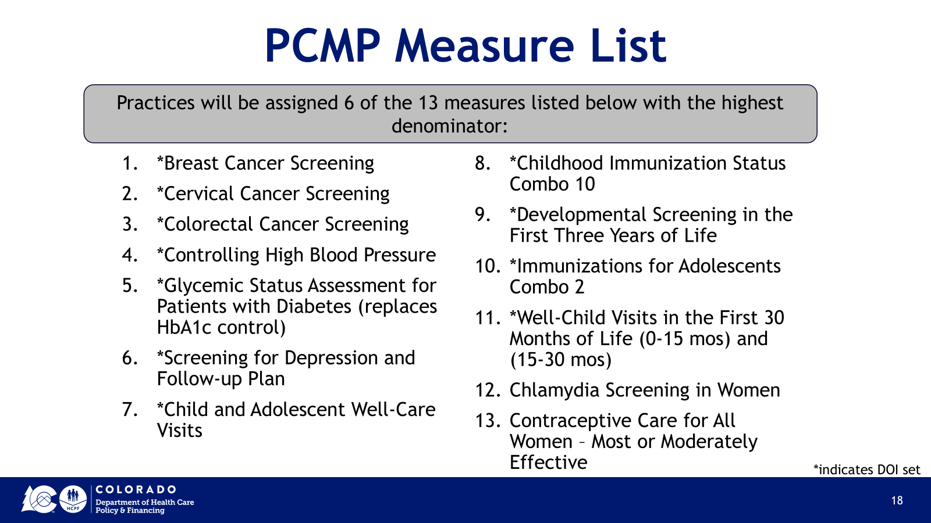
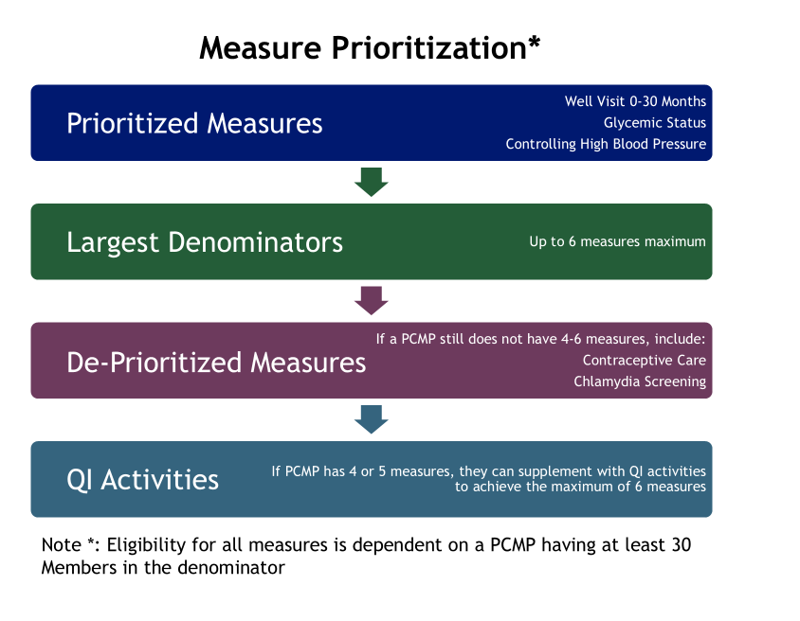
Phase III Performance Overview: KPIs
Performance measures are not the same in Phase III
13 measures to choose from; some are prioritized
4-6 measures max
Most are aligned to APM Measures
Most are Aligned to CMS Core Measures
Practices are measured individually, not regionally

Slide 23
Phase III Performance Overview: KPIs
Year 1
Year 2+
Incentive
Payments
No KPIs
KPIs Begin
Because the state is moving to a calendar year, the first payments may not be received until 18 months (or more) after the start of the new contract.
All Practices will engage in Practice Transformation
Performance measurement will be PI activities around improving baseline performance on future KPIs
Practices are broken into ether a Practice Transformation Track or a Performance Measures Track – depending on membership size
Practice Transformation Track will continue PI activities
Performance Track will work on KPIs similar to Phase II
Time to close the calendar year – starting in January of 2026
Plus time to calculate measures

Slide 24
Open Forum

Slide 25

PCMP Website: www.nhprae2.org
Alma Mejorado, Provider Network Consultant: alma@nhpllc.org
Cara Hebert, Provider & Community Relations Director: cara.hebert@nhpllc.org
Raina Ali, Community Relations Manager: raina@nhpllc.org
    970-909-4318
Contact NHP

Slide 26
Thank you!

Slide 27
Supplemental Information: PCMP Contracting Process

Slide 28
PCMP Key Dates for Contracting and Attribution
NHP Conducts Provider Meet and Greets | January – June 2025
NHP initiates individual PCMP Outreach | February 10, 2025
PCMP Practice Sites Complete Practice Assessment Note: must be completed prior to progressing to contracting | March 4, 2025 Extension to March 14, 2025
PCMP Submits Practice Demographics | March 5 - April 7, 2025
PCMP submits completed supporting documents (i.e. W9, BAA) | March 5 – May 15, 2025
NHP Submit Final List of Contracted PCMP to HCPF | April 7, 2025 (change from 4/30)
Execute Provider Agreements | April 2 – May 15, 2025
HCPF begins member attribution process | May 1, 2025
HCPF begins member noticing of ACC Phase 3 | May 15, 2025
ACC Phase III Program Launch Date | July 1, 2025

Slide 29
Key steps in the contracting process
1. Ensuring enrollment in Health First Colorado (Medicaid).
2. Completing the Practice Assessment by PCMP Practice Site.
3. Submitting Supporting Documents.
4. Reviewing and signing contract sent via DocuSign.

Slide 30
Step 1: Medicaid Enrolled
Physician (Code 05)
Osteopath (Code 26)
FQHC (Code 32)
RHC (Code 45)
School Health Services (Code 51)
Family/Pediatric Nurse Practitioner (Code 41)
Clinic-Practitioner Group (Code 16)
Non-physician Practitioner Group (Code 25)
The practice, agency, or individual Provider, as applicable, renders services utilizing one of the Medicaid Provider types.
Visit Health First Colorado (Medicaid)

Slide 31
Practice Assessment Audit
PCMPs attest the information on the Practice Assessment is accurate.
Evidence is not required at the time of attestation.
Practice sites will be audited to evidence the elements noted are accurate.
NHP is working on audit process and will be communicated when completed.
PCMPs with NCQA or AAHC as PCMH will need to show document, if applicable.

Slide 32
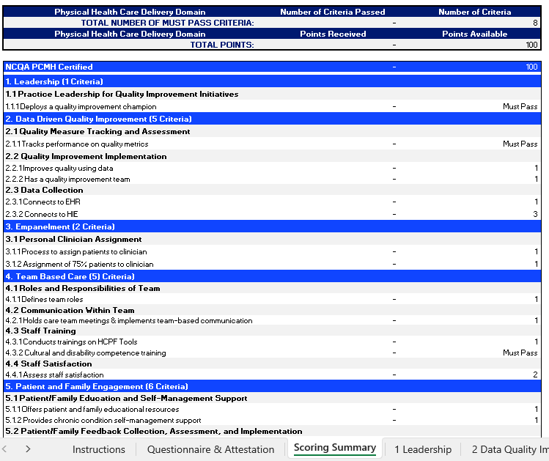
Step 2: Practice Assessment
Phase III will include 3 different PCMP tiers based on capabilities and engagement
Tiers will be based on score from practice assessment for each practice site
To obtain Practice Assessment template visit PCMP Contracting Website.
Notes:
HCPF, or the department, is highly involved in Phase 3 in the PCMP model.
As directed by HCPF, Phase 3 will include 3 different PCMP tiers based on the individual practice capabilities and engagement.
Also, HCPF created a Practice Assessment used by all RAEs to determine these capabilities and engagement across 9 sections. Examples of these are visible in the right side of the screen.
Each of your practices will need to complete a Practice Assessment before contracting. We currently are asking all PCMPs to complete the assessment by March 4th.
The deadline is a little tight because we want to make sure we meet all the HCPF deadlines and ensure that we contract with all practices in our region and we can submit the final report to HCPF by April 30th.
If you need more time or have questions about the tool, please contact me. We want to work with you to successfully complete it.
If you have not received the Practice Assessment template, please contact me directly and I´ll forward to you.
Any questions about this information?

Slide 33
Practice Assessment Scoring
Total of 100 points available out of the 9 Physical Health Care Delivery Domains.
  Tier 1: 0-33 points Tier 2: 34-66 points Tier 3: 67-100 points
For Tier 2 and Tier 3, practice has to meet ALL ¨Must Pass¨ criteria.
If one or more “Must Pass” criteria is not met, then a practice will fall in Tier 1, regardless of the points received.
For practice with NCQA or AAAHC as PCMH and ALL ¨Must Pass¨ criteria is met, then fall in Tier 3.
For practice with NCQA or AAHC as PCMH but one or more ¨Must Pass” criteria is not met, then fall in Tier 2.

Slide 34
Practice Assessment Audit
PCMPs attest the information on the Practice Assessment is accurate.
Evidence is not required at the time of attestation.
Practice sites will be audited to evidence the elements noted are accurate.
NHP is working on audit process and will be communicated when completed.
PCMPs with NCQA or AAHC as PCMH will need to show document, if applicable.

Slide 35
Step 3: Supporting Documents
PCMP Practice Site(s) and Practitioner Demographic information form.
  Please review and complete the 3 tabs.
    GENERAL - Make sure to complete the tab and include the best contacts.
    PRACTICE SITES - all Medicaid Enrolled within the Region 2 counties.
    PRACTITIONERS - medical care providers within the Practice Sites.
W-9 Form
You can find the templates to the documents in
our dedicated PCMP Contracting Website.
Notes:
PCMP contracted with the RAE assigned to your county will allow the PCMP practices to be the Medical Home for the members attributed. PCMPs will receive a Per Member Per Month payment for those members attributed.
Other services that the PCMP will receive is:
-Care coordination support, specifically in transitions of care from hospitalizations and support for complex members.
-Practice Transformation support to enhance your practice as a medical home
-Potential to earn incentives based on performance of the individual practices based on performance measures.
The PMPM amounts and performance measures are being finalized based on the final budget with the State. We are hoping to have completed soon.
In the meantime, work with me to get you ready when the contract is released.

Slide 36
Supporting Documents
Tiers 2 & 3
Submit additional documents:
BAA Form
IT Security Assessment
Once finalized, the templates will be available in our dedicated PCMP Contracting Website.

Slide 37
Step 4: Execute Contract
PCMP contracts is in final stages.
Will issue via Docusign to person authorized to sign.
PMPM amounts are still being determined by the state.
NHP will release PMPM framework after final budget.
PMPM rate will be made based on the Practice Site tier level from Practice Assessments.
Notes:
PCMP contracted with the RAE assigned to your county will allow the PCMP practices to be the Medical Home for the members attributed. PCMPs will receive a Per Member Per Month payment for those members attributed.
Other services that the PCMP will receive is:
-Care coordination support, specifically in transitions of care from hospitalizations and support for complex members.
-Practice Transformation support to enhance your practice as a medical home
-Potential to earn incentives based on performance of the individual practices based on performance measures.
The PMPM amounts and performance measures are being finalized based on the final budget with the State. We are hoping to have completed soon.
In the meantime, work with me to get you ready when the contract is released.

Slide 38
Member Attribution

Slide 39
Physical Health Attribution & Performance Measures
Phase III Attribution
Assigns members to clinics based on claims
NO geographical attribution to PCMP
NO family utilization assessment
If the member has no claims, they will not be assigned a PCMP. The RAE will be responsible for assigning a PCMP.
Performance measures are clinic-specific and are not dependent on regional performance
Phase II Attribution
Based on geography
Uses a family-centric model
Assigns members to clinics
PCMPs are responsible for all assigned members
Performance incentives are RAE-specific and depend on regional performance
Notes:
Data for claims is within the last 18 months.
If the member is not attributed to a PCMP, then they are attributed to a RAE based on geography It is the responsibility of RAE to connect member to a PCMP. There MAY be an incentive to PCMPs for engaging non attributed members.
Attribution will be run quarterly for attributed members. For members with no attribution will be run Monthly to check for claims.
If you have members that have not been within the last 18 months, there is benefit to get them in for a visit.
Are there types of codes? Any codes except emergency. Based on volume and recent.

Slide 40
Determining PCMP Tier Level

Slide 41
Practice Assessment Scoring Methodology
Tier 1 | 0-33 points or 34-100 points and one or more ¨Must Pass¨ criteria were not met.
Tier 2 | 34-66 points and all ¨Must Pass¨ criteria met or Practice has NCQA PCMH or AAAHC and one or more ¨Must Pass¨ criteria were not met.
Tier 3 | 67-100 points and all ¨Must Pass¨ criteria met or NCQA PCMH or AAAHC and all ¨Must Pass¨ criteria met.
The Practice Assessment will identify the highest tier level for which a PCMP Practice Site qualifies.
The Practice Assessment is one component of the Tiering process.
There are added requirements for providers, specifically around care coordination.

Slide 42
What is the Appropriate Tier Level?
Tier 3
Care Coordination: Meet Tier 3 Requirements
Practice Assessment: Score Tier 3 Level
>
Yes
>
Tier 1 or 2
No
>

Slide 43
PCMP Practice Sites have Options
1- Participate at the highest tier for which they qualify.
2- Participate at a lower tier than for which they qualify.
3 - Identify a higher tier and work towards achieving that tier.
NHP will provide tools and resources to support practices at any level.

Slide 44
PMPM Payment Structure

Slide 45
PMPM Maximum Payment Structure
 | Tier 1 | Tier 2 | Tier 3
PMPM Max (up to) | $2.00 | $4.50 | $10.00
Practice Assessment (7%) | $0.14 (7% of $2.00) | $0.32 (7% of $4.50) | $0.70 (7% of $10.00)
CC and Acuity (70%) | $1.40 (70% of $2.00) | $3.15 (70% of $4.50) | $7.00 (70% of $10.00)
Integrated BH (7%) | $0.14 (7% of $2.00) | $0.32 (7% of $4.50) | $0.70 (7% of $10.00)
Special Programs (16%) | $0.32 (16% of $2.00) | $0.72 (16% of $4.50) | $1.60 (16% of $10.00)

Slide 46
PCMP Tier Levels: Responsibilities & Expectations

Slide 47
Requirements for ALL PCMP Practice Sites
  Engage with Practice Transformation Coach and participate in Practice Transformation activities in Year 1.
  Assign a Point of Contact to respond to NHP Care Coordination Team within 24 hours.
  Conduct EPSDT standardize screening tools, including behavioral health screening tools.
  Participate in the Departments incentive programs including but not limited to Alternative Payment Model (APM), Key Performance Indicators (KPI), and/or other incentive programs when eligible.
  Participate in NHP incentive programs or quality measure improvement activities.
Notes:
Conduct EPSDT standardize screening tools, including behavioral health screening tools. NHP will offer training and support, as appropriate, to meet the requirements.
Ensure timely follow-up and care coordination for children with positive screenings requiring additional assessment and treatment.
Improve access to at-risk populations (foster children, children with disabilities & first-time Medicaid enrollees).

Slide 48
Tier 1
Refer to NHP complex CC cases, Conduct brief SDOH screenings, Participate in shared care planning, Support community and specialty referrals
PCMP Responsibilities
Tier 2 SDOH screening and navigation, Manage care transitions, Specialty referrals, Lead CC for members with chronic condition, Document missed care appts, Provide EPSDT outreach and tracking, Document care plan compliance, Use of Department tools, Capability to exchange data
NHP Responsibilities
Tier 3 Document in Essette, Open panel, lead CC role on complex cases, Respond to crisis follow up requests, Conduct comprehensive assessments/screenings, Regularly attend CC subcommittee and partnership meetings, Monthly complex member engagement, Complete and document comprehensive care plan interventions, Meet CC state performance standards.
Notes:
Open Panels = Accepts auto assignments and new members
CC= Care Coordination
Department Tools Include Prescriber Tools phase I & II, eConsult, etc.

Slide 49
Tier 3 Responsibility: Care Coordination
Lead Care Coordination activities for all attributed members based on level of care.
Participate in complex care member meetings when requested by NHP
Reporting requirements for complex members and priority populations.
  Adhere to timeline of documentation requirements.
Open panels accept auto assignments and new members, including COUP
ESSETTE use starting July 1, 2025.
  Assign a superuser to help other staff with questions regarding documentation when/if it comes up

Slide 50
Tier 3 Responsibility: Care Coordination Levels of Care
Level of Care | Minimum Activities | Minimum Populations that must be in this tier
 |  | Adults | Children | Both
Complex Health Management | Comprehensive needs assessment Min monthly coordination with member and treatment team Long-term monitoring/support | Chronic Over-utilization program Individuals involved in Complex Solutions Meetings Deemed ITP in previous year | CANS Assessment indicating high needs Individuals involved in Creative Solutions Meetings Child welfare and foster care emancipation | 2+uncontrolled physical and/or behavioral health conditions Denied private duty nursing Utilization (in previous 6 months): 2+ hospital readmission 30+ days inpatient 3+ crisis contacts 3+ ED visits
Condition Management | Assessment based on population/need Condition-based care plan Min quarterly treatment plan Condition Management Long-term monitoring/support | Value-based payment identified conditions not already listed under ¨both¨ Category | CANS Assessment indicating moderate needs Obesity Pervasive Developmental Disorder | Diabetes Asthma Pregnancy (peri & post natal) Substance Use Disorder Depression/Anxiety
Prevention | Brief Needs Screen Short-term monitoring/support Prevention outreach and education | Adult preventative screenings | Well child visits Child immunizations | Dental visits

Slide 51
NHP System-Wide Coordination & Oversight
Member Services
Coordinate intensive wraparound services for MSOC youth
All Transitions of Care from hospitals, residential BH, etc.
Facilitate Creative/Complex Solutions meetings
Crisis Encounter Follow-Up: follow-up within 5 days
Outreach to unattributed members for engagement
Collaborate with BHASOs, CMAs, child welfare, DSNP, PDN, IMD Transitions
Data Exchange and Monitoring:
  Monthly contact with member and team; Meet care plan creation and contact performance standards
  Ensure comprehensive care plan (90 days/biannual updates) for complex members
  Ensure appropriate care coordination interventions for stratified Member tiers
  Ensure members receive EPSDT Initial Outreach
  Oversight
  Audit Practice Assessments attestations and Care Coordination activities
Notes:
Details regarding the list:
*MSOC youth: Coordinate intensive wraparound (e.g., High-Fidelity Wraparound) and participate in treatment teams led by Enhanced HFW; Coordinate Medicaid-covered BH services not provided under MSOC; Provide 6+ months of follow-up coordination post-discharge from MSOC
*All Transitions of Care from hospitals, residential BH, etc.; Collaborate with discharging entities to implement follow-up plans; Schedule and support post-discharge appointments
*EPSDT Initial Outreach within 60 days; notifications to providers of members not engaged in treatment in last 12 months
*Facilitate Creative/Complex Solutions meetings for youth and adults
Data: Monthly contact with member and team; Meet care plan creation and contact performance standards (e.g., 25 per 1,000 members/year)
Outreach to unattributed members for engagement/attribution-Managing Unassigned Members; Community-based care coordination--home based care coordination/community
Supportive Housing Navigation-identify housing options, assist members in filing housing applications, and coordinate provision of supportive housing and related services. Form partnerships with other organizations (including Continuums of Care).
Data: Ensure comprehensive care plan (90 days/biannual updates) for complex members
Collaborate with BHASOs, CMAs, child welfare, DSNP, PDN, IMD Transitions
Crisis Encounter Follow-Up: follow-up within 5 days
Data/Analysis: Ensure appropriate care coordination interventions for stratified Member tiers

Slide 52
Next Steps for Tier 3 Implementation
1- Confirm PCMP Practice Site(s) agrees to perform Tier 3 requirements by May 15th.
2- Engage appropriate staff for training
3- Collaborate with NHP to institute Essette for documentation and reporting

