Slide 1
Northeast Health Partners
RAE 2
April 9, 2025

Slide 2
Introductions

Slide 3
Member Attribution

Slide 4
Physical Health Attribution & Performance Measures
Phase III Attribution
Assigns members to clinics based on claims
NO geographical attribution to PCMP
NO family utilization assessment
If the member has no claims, they will not be assigned a PCMP. The RAE will be responsible for assigning a PCMP.
Performance measures are clinic-specific and are not dependent on regional performance
Phase II Attribution
Based on geography
Uses a family-centric model
Assigns members to clinics
PCMPs are responsible for all assigned members
Performance incentives are RAE-specific and depend on regional performance
Notes:
Data for claims is within the last 18 months.
If the member is not attributed to a PCMP, then they are attributed to a RAE based on geography It is the responsibility of RAE to connect member to a PCMP. There MAY be an incentive to PCMPs for engaging non attributed members.
Attribution will be run quarterly for attributed members. For members with no attribution will be run Monthly to check for claims.
If you have members that have not been within the last 18 months, there is benefit to get them in for a visit.
Are there types of codes? Any codes except emergency. Based on volume and recent.

Slide 5
PCMP Key Dates for Contracting and Attribution
NHP Conducts Provider Meet and Greets | January – June 2025
NHP initiates individual PCMP Outreach | February 10, 2025
PCMP Practice Sites Complete Practice Assessment Note: must be completed prior to progressing to contracting | March 4, 2025 Extension to March 14, 2025
PCMP Submits Practice Demographics | March 5 - April 7, 2025
PCMP submits completed supporting documents (i.e. W9, BAA) | March 5 – May 15, 2025
NHP Submit Final List of Contracted PCMP to HCPF | April 7, 2025 (change from 4/30)
Execute Provider Agreements | April 2 – May 15, 2025
HCPF begins member attribution process | May 1, 2025
HCPF begins member noticing of ACC Phase 3 | May 15, 2025
ACC Phase III Program Launch Date | July 1, 2025

Slide 6
PMPM Payment Structure

Slide 7
PMPM Maximum Payment Structure
 | Tier 1 | Tier 2 | Tier 3
PMPM Max (up to) | $2.00 | $4.50 | $10.00
Practice Assessment (7%) | $0.14 (7% of $2.00) | $0.32 (7% of $4.50) | $0.70 (7% of $10.00)
CC and Acuity (70%) | $1.40 (70% of $2.00) | $3.15 (70% of $4.50) | $7.00 (70% of $10.00)
Integrated BH (7%) | $0.14 (7% of $2.00) | $0.32 (7% of $4.50) | $0.70 (7% of $10.00)
Special Programs (16%) | $0.32 (16% of $2.00) | $0.72 (16% of $4.50) | $1.60 (16% of $10.00)

Slide 8
Key Components of the PMPM
PMPM payments covers the following components:
Practice Assessment Completion
Care Coordination and Acuity Payments
Other Programs
Integrated Behavioral Health

Slide 9
Practice Assessment (PA) Scoring Methodology
Tier 1 | 0-33 points or 34-100 points and one or more ¨Must Pass¨ criteria were not met.
Tier 2 | 34-66 points and all ¨Must Pass¨ criteria met or Practice has NCQA PCMH or AAAHC and one or more ¨Must Pass¨ criteria were not met.
Tier 3 | 67-100 points and all ¨Must Pass¨ criteria met or NCQA PCMH or AAAHC and all ¨Must Pass¨ criteria met.
The Practice Assessment will identify the highest tier level for which a PCMP Practice Site qualifies.
The Practice Assessment is one component of the Tiering process.
There are added requirements for providers, specifically around care coordination.
The PCMP Practice Sites have the option to participate at the highest tier for which they qualify, or they can opt to participate at a lower tier.
PCMP Practice Sites also may opt to identify a higher tier and work towards achieving that tier. NHP will provide tools and resources to support their advance across tier levels.

Slide 10
PCMP Tier Levels: Responsibilities & Expectations

Slide 11
Requirements for ALL PCMP Practice Sites
Engage with Practice Transformation Coach and participate in Practice Transformation activities in Year 1.
Assign a Point of Contact to respond to NHP Care Coordination Team within 24 hours.
Conduct EPSDT standardize screening tools, including behavioral health screening tools.
Participate in the Departments incentive programs including but not limited to Alternative Payment Model (APM), Key Performance Indicators (KPI), and/or other incentive programs when eligible.
Participate in NHP incentive programs or quality measure improvement activities.
Notes:
Conduct EPSDT standardize screening tools, including behavioral health screening tools. NHP will offer training and support, as appropriate, to meet the requirements.
Ensure timely follow-up and care coordination for children with positive screenings requiring additional assessment and treatment.
Improve access to at-risk populations (foster children, children with disabilities & first-time Medicaid enrollees).

Slide 12
Tier 2 SDOH screening and navigation, Manage care transitions, Specialty referrals, Lead CC for members with chronic condition, Document missed care appts, Provide EPSDT outreach and tracking, Document care plan compliance, Use of Department tools, Capability to exchange data
Tier 3 Document in Essette, Open panel, lead CC role on complex cases, Respond to crisis follow up requests, Conduct comprehensive assessments/screenings, Regularly attend CC subcommittee and partnership meetings, Monthly complex member engagement, Complete and document comprehensive care plan interventions, Meet CC state performance standards.
Tier 1
Refer to NHP complex CC cases, Conduct brief SDOH screenings, Participate in shared care planning, Support community and specialty referrals
PCMP Responsibilities
NHP Responsibilities
Notes:
Open Panels = Accepts auto assignments and new members
CC= Care Coordination
Department Tools Include Prescriber Tools phase I & II, eConsult, etc.

Slide 13
NHP System-Wide Coordination & Oversight
Member Services
Coordinate intensive wraparound services for MSOC youth
All Transitions of Care from hospitals, residential BH, etc.
Facilitate Creative/Complex Solutions meetings
Crisis Encounter Follow-Up: follow-up within 5 days
Outreach to unattributed members for engagement
Collaborate with BHASOs, CMAs, child welfare, DSNP, PDN, IMD Transitions
Data Exchange and Monitoring:
Monthly contact with member and team; Meet care plan creation and contact performance standards
Ensure comprehensive care plan (90 days/biannual updates) for complex members
Ensure appropriate care coordination interventions for stratified Member tiers
Ensure members receive EPSDT Initial Outreach
Oversight
Audit Practice Assessments attestations and Care Coordination activities
Notes:
Details regarding the list:
*MSOC youth: Coordinate intensive wraparound (e.g., High-Fidelity Wraparound) and participate in treatment teams led by Enhanced HFW; Coordinate Medicaid-covered BH services not provided under MSOC; Provide 6+ months of follow-up coordination post-discharge from MSOC
*All Transitions of Care from hospitals, residential BH, etc.; Collaborate with discharging entities to implement follow-up plans; Schedule and support post-discharge appointments
*EPSDT Initial Outreach within 60 days; notifications to providers of members not engaged in treatment in last 12 months
*Facilitate Creative/Complex Solutions meetings for youth and adults
Data: Monthly contact with member and team; Meet care plan creation and contact performance standards (e.g., 25 per 1,000 members/year)
Outreach to unattributed members for engagement/attribution-Managing Unassigned Members; Community-based care coordination--home based care coordination/community
Supportive Housing Navigation-identify housing options, assist members in filing housing applications, and coordinate provision of supportive housing and related services. Form partnerships with other organizations (including Continuums of Care).
Data: Ensure comprehensive care plan (90 days/biannual updates) for complex members
Collaborate with BHASOs, CMAs, child welfare, DSNP, PDN, IMD Transitions
Crisis Encounter Follow-Up: follow-up within 5 days
Data/Analysis: Ensure appropriate care coordination interventions for stratified Member tiers

Slide 14
Call to Action
Communicate with your team on the requirements
Email Contracting@nhpllc.org to discuss the tier and make appropriate adjustments
Engage with NHP to prepare to meet requirements starting 7/1/2025.
Notes:
Reach out to your SMEs to see if this work you can do.
Let´s schedule a meeting to discuss further.

Slide 15
Open Forum

Slide 16
PCMP Website: www.nhprae2.org
Alma Mejorado, Provider Network Consultant: alma@nhpllc.org
Cara Hebert, Provider & Community Relations Director: cara.hebert@nhpllc.org
Raina Ali, Community Relations Manager: raina@nhpllc.org
970-909-4318
Contact NHP

Slide 17
Thank you!

Slide 18
Supplemental Information: PCMP Contracting Process

Slide 19
Key steps in the contracting process
1. Ensuring enrollment in Health First Colorado (Medicaid).
2. Completing the Practice Assessment by PCMP Practice Site.
3. Submitting Supporting Documents.
4. Reviewing and signing contract sent via DocuSign.

Slide 20
Step 1: Medicaid Enrolled
Physician (Code 05)
Osteopath (Code 26)
FQHC (Code 32)
RHC (Code 45)
School Health Services (Code 51)
Family/Pediatric Nurse Practitioner (Code 41)
Clinic-Practitioner Group (Code 16)
Non-physician Practitioner Group (Code 25)
The practice, agency, or individual Provider, as applicable, renders services utilizing one of the Medicaid Provider types.
Visit Health First Colorado (Medicaid)

Slide 21
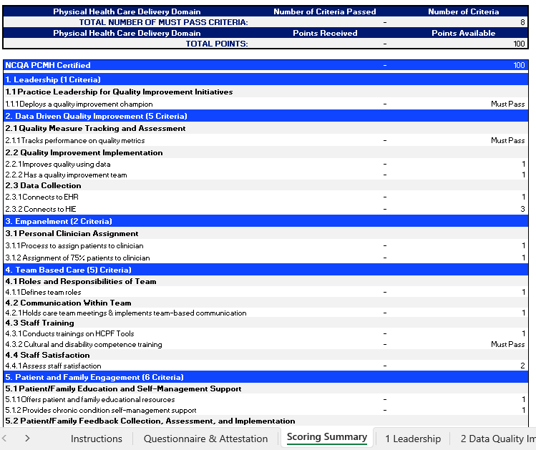
Step 2: Practice Assessment
Phase III will include 3 different PCMP tiers based on capabilities and engagement
Tiers will be based on score from practice assessment for each practice site
To obtain Practice Assessment template visit PCMP Contracting Website.
Notes:
HCPF, or the department, is highly involved in Phase 3 in the PCMP model.
As directed by HCPF, Phase 3 will include 3 different PCMP tiers based on the individual practice capabilities and engagement.
Also, HCPF created a Practice Assessment used by all RAEs to determine these capabilities and engagement across 9 sections. Examples of these are visible in the right side of the screen.
Each of your practices will need to complete a Practice Assessment before contracting. We currently are asking all PCMPs to complete the assessment by March 4th.
The deadline is a little tight because we want to make sure we meet all the HCPF deadlines and ensure that we contract with all practices in our region and we can submit the final report to HCPF by April 30th.
If you need more time or have questions about the tool, please contact me. We want to work with you to successfully complete it.
If you have not received the Practice Assessment template, please contact me directly and I´ll forward to you.
Any questions about this information?

Slide 22
Practice Assessment Scoring
Total of 100 points available out of the 9 Physical Health Care Delivery Domains.
Tier 1: 0-33 points Tier 2: 34-66 points Tier 3: 67-100 points
For Tier 2 and Tier 3, practice has to meet ALL ¨Must Pass¨ criteria.
If one or more “Must Pass” criteria is not met, then a practice will fall in Tier 1, regardless of the points received.
For practice with NCQA or AAAHC as PCMH and ALL ¨Must Pass¨ criteria is met, then fall in Tier 3.
For practice with NCQA or AAHC as PCMH but one or more ¨Must Pass” criteria is not met, then fall in Tier 2.

Slide 23
Practice Assessment Audit
PCMPs attest the information on the Practice Assessment is accurate.
Evidence is not required at the time of attestation.
Practice sites will be audited to evidence the elements noted are accurate.
NHP is working on audit process and will be communicated when completed.
PCMPs with NCQA or AAHC as PCMH will need to show document, if applicable.

Slide 24
Step 3: Supporting Documents
PCMP Practice Site(s) and Practitioner Demographic information form.
Please review and complete the 3 tabs.
GENERAL - Make sure to complete the tab and include the best contacts.
PRACTICE SITES - all Medicaid Enrolled within the Region 2 counties.
PRACTITIONERS - medical care providers within the Practice Sites.
W-9 Form
You can find the templates to the documents in
our dedicated PCMP Contracting Website.
Notes:
PCMP contracted with the RAE assigned to your county will allow the PCMP practices to be the Medical Home for the members attributed. PCMPs will receive a Per Member Per Month payment for those members attributed.
Other services that the PCMP will receive is:
-Care coordination support, specifically in transitions of care from hospitalizations and support for complex members.
-Practice Transformation support to enhance your practice as a medical home
-Potential to earn incentives based on performance of the individual practices based on performance measures.
The PMPM amounts and performance measures are being finalized based on the final budget with the State. We are hoping to have completed soon.
In the meantime, work with me to get you ready when the contract is released.

Slide 25
Supporting Documents Tiers 2 & 3
Submit additional documents:
BAA Form
IT Security Assessment
Once finalized, the templates will be available in our dedicated PCMP Contracting Website.

Slide 26
Step 4: Execute Contract
PCMP contracts is in final stages.
Will issue via Docusign to person authorized to sign.
PMPM amounts are still being determined by the state.
NHP will release PMPM framework after final budget.
PMPM rate will be made based on the Practice Site tier level from Practice Assessments.
Notes:
PCMP contracted with the RAE assigned to your county will allow the PCMP practices to be the Medical Home for the members attributed. PCMPs will receive a Per Member Per Month payment for those members attributed.
Other services that the PCMP will receive is:
-Care coordination support, specifically in transitions of care from hospitalizations and support for complex members.
-Practice Transformation support to enhance your practice as a medical home
-Potential to earn incentives based on performance of the individual practices based on performance measures.
The PMPM amounts and performance measures are being finalized based on the final budget with the State. We are hoping to have completed soon.
In the meantime, work with me to get you ready when the contract is released.

