Slide 1
Northeast Health Partners
RAE 2
March 12, 2025

Slide 2
Introductions

Slide 3
PCMP Contracting Process

Slide 4
Key steps in the contracting process
1. Ensuring enrollment in Health First Colorado (Medicaid).
2. Completing the Practice Assessment by PCMP Practice Site.
3. Submitting Supporting Documents.
4. Reviewing and signing contract sent via DocuSign.

Slide 5
Step 1: Medicaid Enrolled
Physician (Code 05)
Osteopath (Code 26)
FQHC (Code 32)
RHC (Code 45)
School Health Services (Code 51)
Family/Pediatric Nurse Practitioner (Code 41)
Clinic-Practitioner Group (Code 16)
Non-physician Practitioner Group (Code 25)
The practice, agency, or individual Provider, as applicable, renders services utilizing one of the Medicaid Provider types.
Visit Health First Colorado (Medicaid)

Slide 6
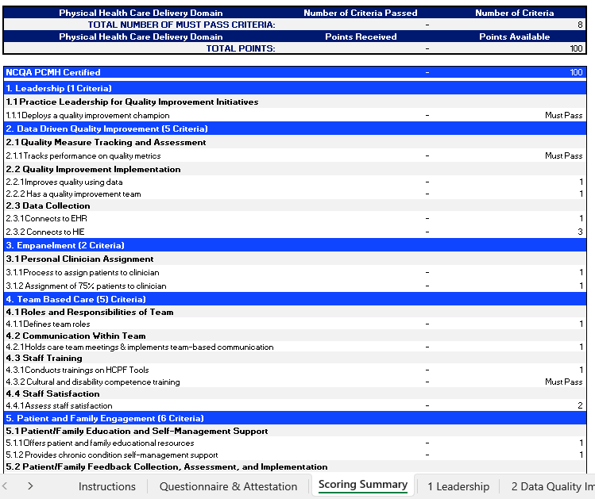
Step 2: Practice Assessment
Phase III will include 3 different PCMP tiers based on capabilities and engagement
Tiers will be based on score from practice assessment for each practice site
To obtain Practice Assessment template visit PCMP Contracting Website.
Notes:
HCPF, or the department, is highly involved in Phase 3 in the PCMP model.
As directed by HCPF, Phase 3 will include 3 different PCMP tiers based on the individual practice capabilities and engagement.
Also, HCPF created a Practice Assessment used by all RAEs to determine these capabilities and engagement across 9 sections. Examples of these are visible in the right side of the screen.
Each of your practices will need to complete a Practice Assessment before contracting. We currently are asking all PCMPs to complete the assessment by March 4th.
The deadline is a little tight because we want to make sure we meet all the HCPF deadlines and ensure that we contract with all practices in our region and we can submit the final report to HCPF by April 30th.
If you need more time or have questions about the tool, please contact me. We want to work with you to successfully complete it.
If you have not received the Practice Assessment template, please contact me directly and I´ll forward to you.
Any questions about this information?

Slide 7
Practice Assessment Scoring
Total of 100 points available out of the 9 Physical Health Care Delivery Domains.
Tier 1: 0-33 points Tier 2: 34-66 points Tier 3: 67-100 points
For Tier 2 and Tier 3, practice has to meet ALL ¨Must Pass¨ criteria.
If one or more “Must Pass” criteria is not met, then a practice will fall in Tier 1, regardless of the points received.
For practice with NCQA or AAAHC as PCMH and ALL ¨Must Pass¨ criteria is met, then fall in Tier 3.
For practice with NCQA or AAHC as PCMH but one or more ¨Must Pass” criteria is not met, then fall in Tier 2.

Slide 8
Practice Assessment Audit
PCMPs attest the information on the Practice Assessment is accurate.
Evidence is not required at the time of attestation.
Practice sites will be audited to evidence the elements noted are accurate.
NHP is working on audit process and will be communicated when completed.
PCMPs with NCQA or AAHC as PCMH will need to show document, if applicable.

Slide 9
Step 3: Supporting Documents
PCMP Practice Site(s) and Practitioner Demographic information form.
Please review and complete the 3 tabs.
GENERAL - Make sure to complete the tab and include the best contacts.
PRACTICE SITES - all Medicaid Enrolled within the Region 2 counties.
PRACTITIONERS - medical care providers within the Practice Sites.
W-9 Form
You can find the templates to the documents in
our dedicated PCMP Contracting Website.
Notes:
PCMP contracted with the RAE assigned to your county will allow the PCMP practices to be the Medical Home for the members attributed. PCMPs will receive a Per Member Per Month payment for those members attributed.
Other services that the PCMP will receive is:
-Care coordination support, specifically in transitions of care from hospitalizations and support for complex members.
-Practice Transformation support to enhance your practice as a medical home
-Potential to earn incentives based on performance of the individual practices based on performance measures.
The PMPM amounts and performance measures are being finalized based on the final budget with the State. We are hoping to have completed soon.
In the meantime, work with me to get you ready when the contract is released.

Slide 10
Supporting Documents Tiers 2 & 3
Submit additional documents:
BAA Form
IT Security Assessment
Once finalized, the templates will be available in our dedicated PCMP Contracting Website.

Slide 11
Step 4: Execute Contract
PCMP contracts is in final stages.
Will issue via Docusign to person authorized to sign.
PMPM amounts are still being determined by the state.
NHP will release PMPM framework after final budget.
PMPM rate will be made based on the Practice Site tier level from Practice Assessments.
Notes:
PCMP contracted with the RAE assigned to your county will allow the PCMP practices to be the Medical Home for the members attributed. PCMPs will receive a Per Member Per Month payment for those members attributed.
Other services that the PCMP will receive is:
-Care coordination support, specifically in transitions of care from hospitalizations and support for complex members.
-Practice Transformation support to enhance your practice as a medical home
-Potential to earn incentives based on performance of the individual practices based on performance measures.
The PMPM amounts and performance measures are being finalized based on the final budget with the State. We are hoping to have completed soon.
In the meantime, work with me to get you ready when the contract is released.

Slide 12
PCMP Key Dates for Contracting and Attribution
NHP Conducts Provider Meet and Greets | January 26, 2025 February 26, 2025 March, April, May, and June
NHP initiates individual PCMP Outreach | February 10, 2025
PCMP Practice Sites Complete Practice Assessment Note: must be completed prior to progressing to contracting | March 4, 2025 Extension to March 14, 2025
Execute Provider Agreements* | March 15- April 20, 2025
PCMP submits completed supporting documents* (i.e. W9, BAA, practice demographics) | March 5 - April 20, 2025
NHP Submit Final List of Contracted PCMP to HCPF | April 30, 2025
HCPF begins member attribution process | May 1, 2025
HCPF begins member noticing | May 15, 2025
ACC Phase III Program Launch Date | July 1, 2025
Notes:
Here are the key dates of the PCMP Contracting and attribution.
As you can see, there is a lot of work that goes behind the launch date of ACC Phase 3 on July 1st.
All RAEs must submit final list of contracted PCMPs to HCPF on April 30th. HCPF will begin the member attribution process on May 1st and begin member noticing on May 15th.
Your cooperation with completing the Practice Assessment and any supporting documents is crucial to the success of this implementation.
Again, if you need more time or have questions about the tool, please contact me. We want to work with you to successfully contract with us before the HCPF deadline.
Any questions about this information?
Note that we will be scheduling PCMP specific webinars – something like office hours – in the week March 10th to go into more detail.
Dorothy Burke from ???

Slide 13
Open Forum

Slide 14
Contact NHP
PCMP Website
Information for Providers in RAE Region 2 (ACC 3.0) - NHP - Regional Accountable Entity
Alma Mejorado, Provider Network Consultant, alma@nhpllc.org
Raina Ali, Community Relations Manager: raina@nhpllc.org
970-909-4318
Behavioral Health Contracting:
NHPrae_bh_pr@uhc.com
Christopher Miller, Dir. of Provider Relations Christopher_Miller@uhc.com

Slide 15
Thank you!

Slide 16
Physical Health Attribution & Performance Measures
Phase II Attribution
Based on geography
Uses a family-centric model
Assigns members to clinics
PCMPs are responsible for all assigned members
Performance incentives are RAE-specific and depend on regional performance
Phase III Attribution
No geographical attribution
Does not assess family utilization
Assigns members to clinics based on claims
If the member has no claims, they will not be assigned a PCMP. The RAE will be responsible for assigning a PCMP.
Performance measures are clinic-specific and are not dependent on regional performance
Notes:
Hello all. My name is Alma Mejorado and I´m NHPs Provider Network Contractor. I am the key contact person for all Primary Care Providers to contract with NHP to receive member attribution under ACC Phase 3 starting July 1st.
I´ve worked with NHP since its foundation in 2018 and is now delighted to be an official member of the NHP team.
ACC Phase 3 will have important changes from the current process under Phase 2. As they are outlined here. Compared to Phase 2, Phase 3 attribution will
No geographical attribution
Does not assess family utilization
Assigns members to clinics based on claims
That means that
If the member has no claims, they will not be assigned a PCMP. The RAE will be responsible for assigning a PCMP.
Also,
Performance measures are clinic-specific and are not dependent on regional performance
Any questions about this information?

